Slide 1
Development of a Machine Learning System for Aspect-Based Sentiment Analysis and Text Summarization of Video Games Reviews on Steam
Bachelor Thesis Presentation
Department of Computer Science
Faculty of Engineering and Computer Science University of Applied Sciences Hamburg
Supervising examiner: Prof. Dr. Marina Tropmann-Frick
Second examiner: Prof. Dr. Stefan Sarstedt
By Nhat Khanh Huy Tran
13.09.2021

Slide 2
Agenda
Introduction
Opinion summarization of video games reviews
Transfer learning in NLP (natural language processing)
Objectives
Background
Aspect-based sentiment analysis
Text summarization
Data visualzation
System overview
Methods
Aspect extraction
Sentiment analysis
Text summarization
Data visualization
Experiments and evaluation
Conclusion and future work

Slide 3
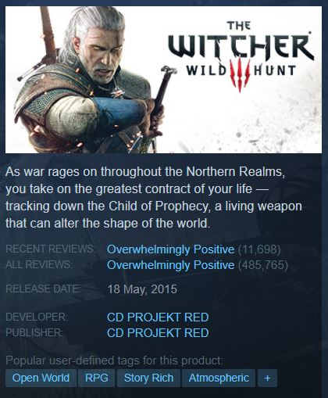


Introduction – Opinion summarization of video game reviews
Gaming Industry
Market Value: $159.3 Billion (2020)
System for automatic opinion summarization of video game reviews
The game The Witcher 3: Wild Hunt with nearly half a million reviews on Steam

Slide 4
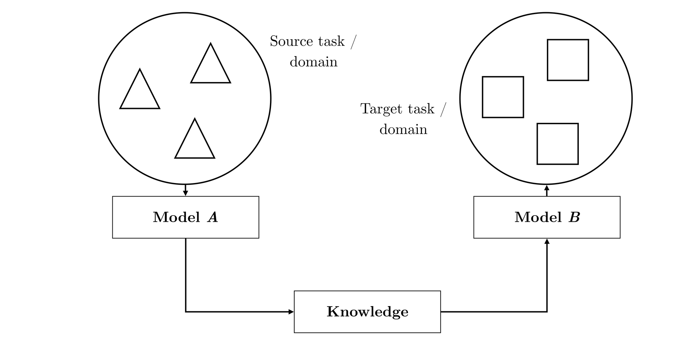
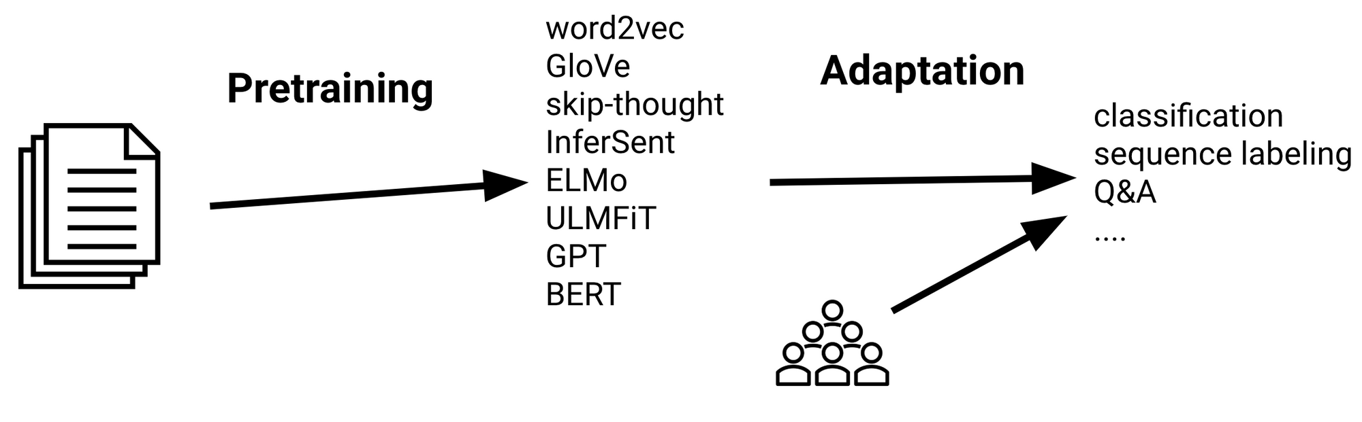
Introduction – Transfer learning in NLP
The process of transfer learning
The general procedure of sequential transfer learning

Slide 5
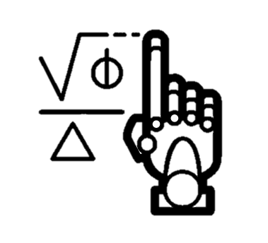


Introduction – Objectives
Gather reviews
Use unsupervised methods for aspect-based sentiment analysis and text summarization
Build a dashboard for data visualization

Slide 6




Background – Aspect-based sentiment analysis (1)
Graphics
Music
Sentiment analysis
Gameplay
Aspect-based sentiment analysis

Slide 7
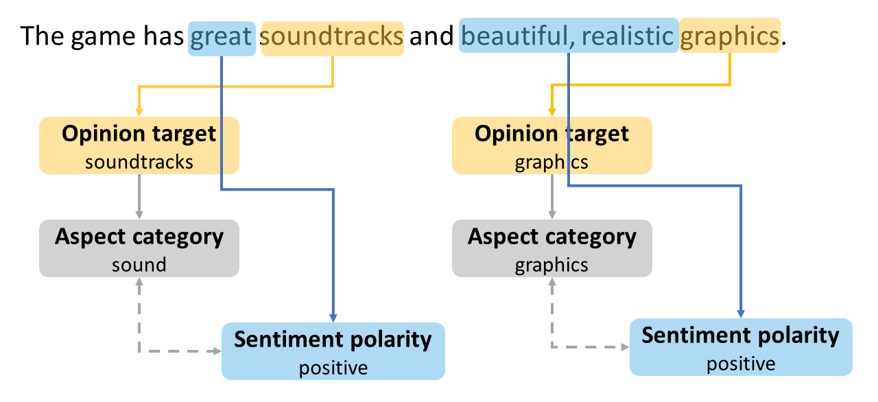
Background – Aspect-based sentiment analysis (2)

Slide 8






Background – Text summarization
vs
vs
vs
Single-document and multi-document
Extractive and abstractive
Generic and query-focused

Slide 9

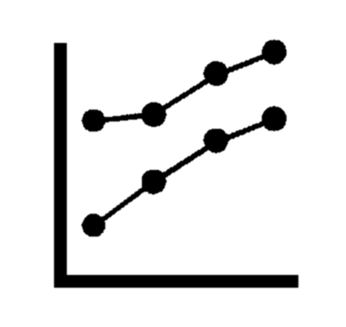
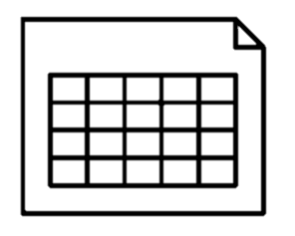




Background – Data visualization (1)
Spreadsheets, reports, reviews
Static charts, graphs
Interactive dashboards

Slide 10
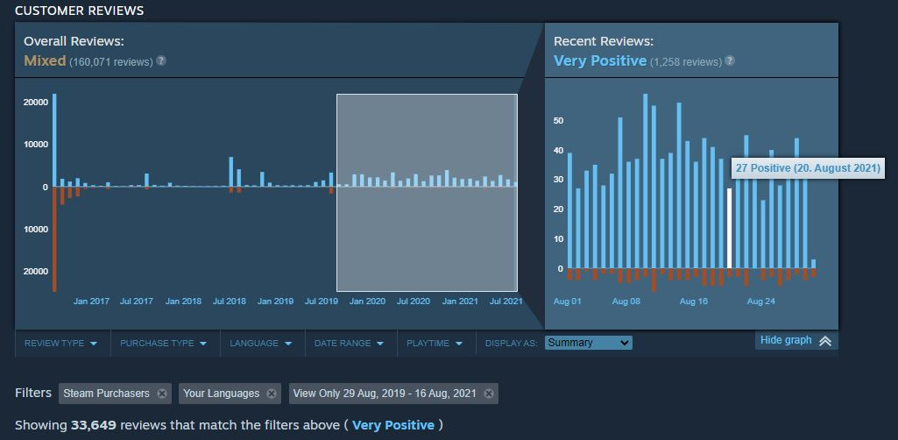
Background – Data visualization (2)

Slide 11
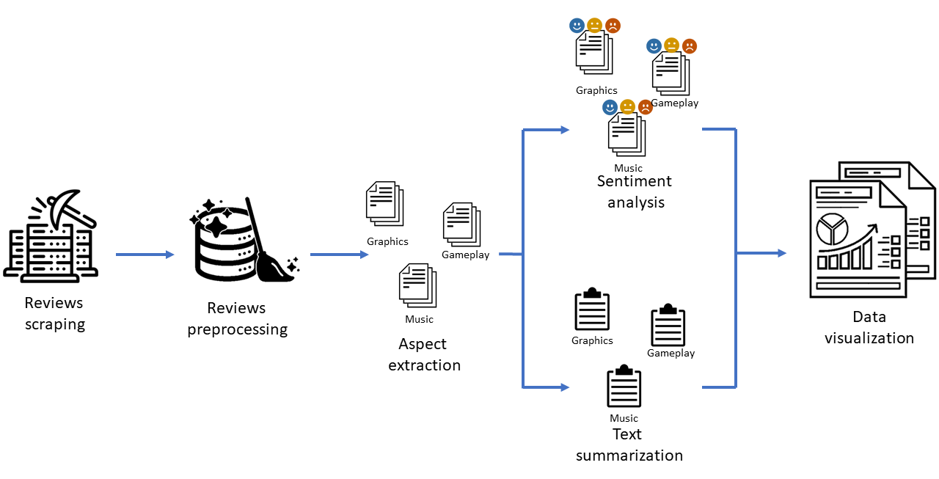
System overview
Pretrained RNN-based sentiment classifer
Power BI
SQLite
POS (part-of-speech) tagging
SBERT (SentenceBERT)
Agglomerative clustering
Steam API
SBERT (SentenceBERT)
HDBSCAN
Agglomerative clustering

Slide 12
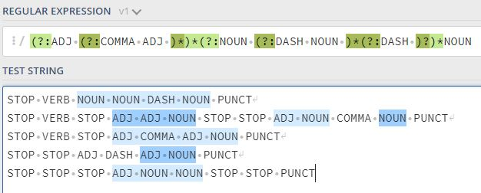
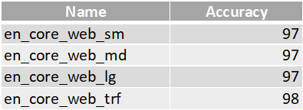
Methods – Aspect extraction (1)
POS tagging accuracy (%) of trained models in spaCy
Regular expression for extracting noun chunks from POS tags strings

Slide 13
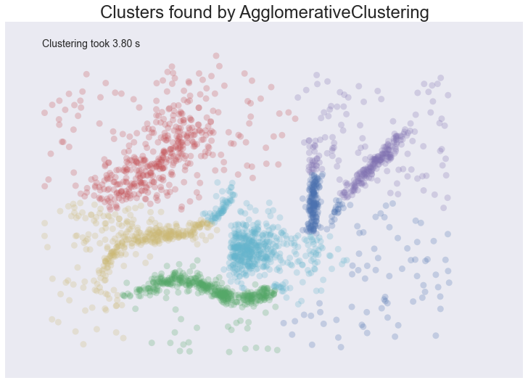
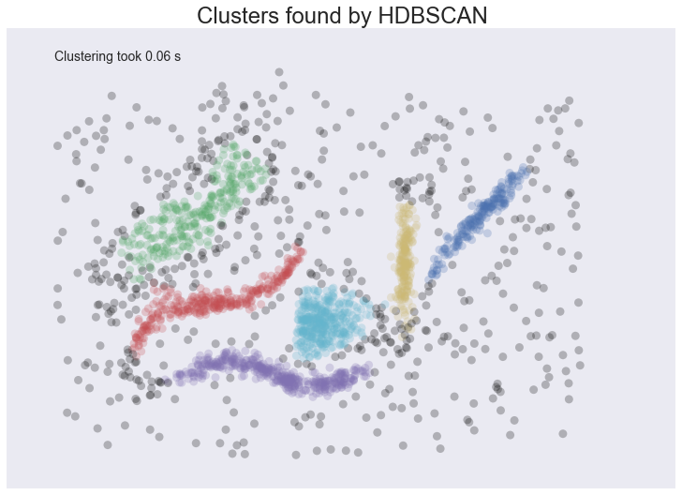
Methods – Aspect extraction (2)
music
soundtrack
great music
great soundtrack
sound
sound design
sound effects
music
graphics
animations
pixel art
animation
visuals
graphics
Grey points detected by HDBSCAN as noise. HDBSCAN doesn’t assume that all the data belongs in clusters with no noise like agglomerative clustering.

Slide 14
Methods – Sentiment analysis (1)
“i do like you” = positive
“I do not like you” = negative

Slide 15
Methods – Sentiment analysis (2)
“…but you can be dumb sometimes” = positive
“…but you can be so dumb sometimes” = less positive

Slide 16
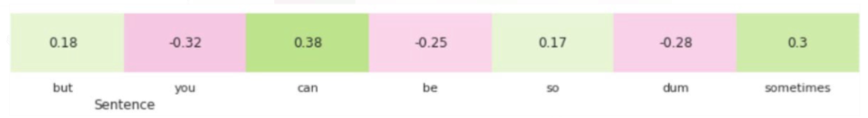
Methods – Sentiment analysis (3)
predicts a negative sentiment for the misspelt word “dum”

Slide 17




Methods – Text summarization
Sentences merging
Sentence ranking
Sentence filtering
Summarization
SBERT (Sentence-BERT)
HDBSCAN
Agglomerative clustering

Slide 18
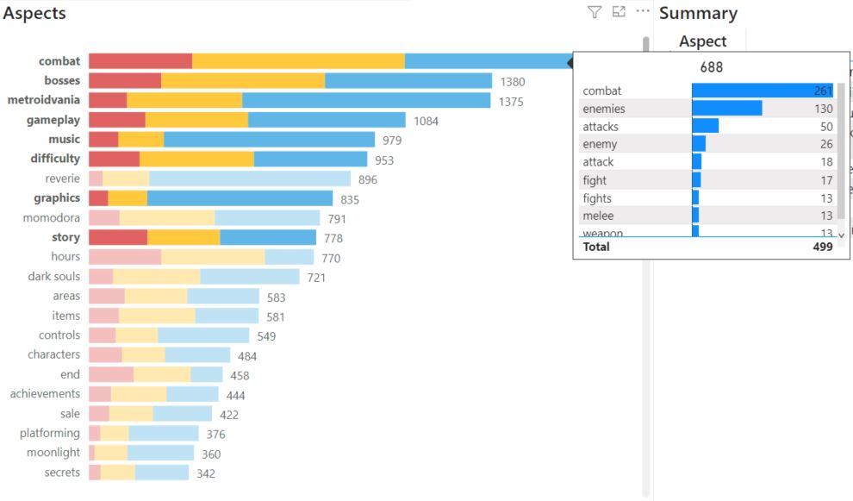
Experiments and evaluation
Dashboard implemented in Power BI

Slide 19
Conclusion and future work

Slide 20
Thank you for your attention!

